Slide 1
Lexical Semantics

Slide 2
Three Perspectives on Meaning
Lexical Semantics
  The meanings of individual words
Formal Semantics (or Compositional Semantics or Sentential Semantics)
  How those meanings combine to make meanings for individual sentences or utterances
Discourse or Pragmatics
  How those meanings combine with each other and with other facts about various kinds of context to make meanings for a text or discourse.
  Dialog or Conversation is often lumped together with Discourse.

Slide 3
Outline: Computational Lexical Semantics
Introduction to Lexical Semantics
  Word relations such as Homonymy, Polysemy, Synonymy
  Online resources: WordNet
Computational Lexical Semantics
  Word Sense Disambiguation
    Supervised
    Semi-supervised
  Word Similarity
    Thesaurus-based
    Distributional

Slide 4
Preliminaries
What’s a word?
  Tokens, stems, roots, uninflected forms, etc…
Lexeme: An entry in a lexicon consisting of a pairing of a form with a single meaning representation
Lexicon: A collection of lexemes
Lemma – citation form – uninflected form (used to represent a lexeme). Need to do morphological parsing to get from wordform to lemma (lemmatization)
Lemma is part-of-speech specific (e.g., table N and V)

Slide 5
Relationships between word meanings
Homonymy
Polysemy
Synonymy
Antonymy
Hypernomy
Hyponomy
Meronomy

Slide 6
Homonymy
Lexemes that share a form
  Phonological (systematic organization of sounds), orthographic or both
But have unrelated, distinct meanings
Clear example:
  Bat (wooden stick-like thing) vs
  Bat (flying scary mammal thing)
  Or bank (financial institution) versus bank (riverside)
Can be homophones, homographs, or both
  Homophones:
    Write and right
    Piece and peace

Slide 7
Homonymy causes problems for NLP applications
Text-to-Speech
  Same orthographic form but different phonological form
    Bass vs bass
    Bow vs bow
    Record vs record
Information retrieval
  Different meanings same orthographic form
    QUERY: bat care
Machine Translation
Speech recognition

Slide 8
Polysemy
The bank is constructed from red brick
I withdrew the money from the bank
Are those the same sense?
What about river bank?
What about: The food bank is having a donation drive next week.
Different senses but some more related than others…
When two senses are related semantically we call it polysemy (rather than homonymy)

Slide 9
Polysemy
A single lexeme with multiple related meanings (bank the building, bank the financial institution)
Most non-rare words have multiple meanings
  The number of meanings is related to its frequency
  Verbs tend more to polysemy
  Distinguishing polysemy from homonymy isn’t always easy (or necessary)

Slide 10
Metaphor and Metonymy
Specific types of polysemy
Metaphor:
  Germany will pull Slovenia out of its economic slump.
  I spent 2 hours on that homework.
  I put money into Google stock.
Metonymy (use of one aspect of a concept or entity to refer to other aspects of the entity or to the entity itself)
  The White House announced yesterday…
    White House refers to the administration whose office is in the White House
  This chapter talks about part-of-speech tagging
  Bank (building) and bank (financial institution)

Slide 11
How do we know when a word has more than one sense?
ATIS examples
  Which flights serve breakfast?
  Does America West serve Philadelphia?
The “zeugma” test:
  ?Does United serve breakfast and San Jose?

Slide 12
Synonyms
Words that have the same meaning in some or all contexts
  Filbert / hazelnut
  Couch / sofa
  Big / large
  Automobile / car
  Vomit / throw up
  Water / H₂O
Two lexemes are synonyms if they can be successfully substituted for each other in all situations
  If so they have the same propositional meaning

Slide 13
Synonyms
But there are few (or no) examples of perfect synonym
  Why should that be?
  Even if many aspects of meaning are identical
  Still may not preserve the acceptability based on notions of politeness, slang, register, genre, etc…
Example
  Water and H₂O
  Large coke versus *big coke

Slide 14
Some more terminology
Lemmas and word forms
  A lexeme is an abstract pairing of meaning and form
  A lemma or citation form is the grammatical form that is used to represent a lexeme
    Carpet is the lemma for carpets
    Corpus is the lemma for corpora
  Specific surface forms carpets, sung, corpora are called wordforms
The lemma bank has two senses:
  Instead, a bank can hold the investments in…
  But as agriculture burgeons on the east bank, the river will shrink even more
A sense is a discrete representation of one aspect of the meaning of a word

Slide 15
Synonymy is a relation between senses rather than words
Consider the words big and large
Are they synonyms?
  How big is that plane?
  Would I be flying on a large or small plane?
How about here:
  Miss Nelson, for instance, became a kind of big sister to Benjamin.
  ?Miss Nelson, for instance, became a kind of large sister to Benjamin.
Why?
  Big has a sense that means being older, or grown up
  Large lacks this sense

Slide 16
Antonyms
Senses that are opposites with respect to one feature of their meaning
Otherwise, they are very similar!
  Dark / light
  Short / long
  Hot / cold
  Up / down
  In / out
More formally: antonyms can
  Define a binary opposition or are at opposite ends of a scale (long/short, fast/slow)

Slide 17
Hyponym
One sense is a hyponym of another if the first sense is more specific, denoting a subclass of the other
  Car is a hyponym of vehicle
  Dog is a hyponym of animal
  Mango is a hyponym of fruit
Conversely
  Vehicle is a hypernym/superordinate of car
  Animal is a hypernym of dog
  Fruit is a hypernym of mango
Superordinate | Vehicle | Fruit | Furniture | mammal
Hyponym | Car | Mango | Chair | Dog

Slide 18
Hyponymy more formally
Extensional:
  The class denoted by the superordinate extensionally includes the class denoted by the hyponym
Entailment
  A sense A is a hyponym of sense B if being an A entails being a B
Hyponymy is usually transitive
  (A hypo B and B hypo C entails A hypo C)

Slide 19
II. Wordnet
A hierarchically organized lexical database
On-line thesaurus + aspects of a dictionary
Category | Unique Forms
Noun | 117,097
Verb | 11,488
Adjective | 22,141
Adverb | 4,601

Slide 20
Wordnet
Where it is:
http://wordnetweb.princeton.edu/perl/webwn

Slide 21
Format of WordNet Entries
The noun bass has 8 senses in wordnet:
S: (n) bass (the lowest part of the musical range)
S: (n) bass, bass part (the lowest part in polyphonic music)
S: (n) bass, basso (an adult male singer with the lowest voice)
S: (n) sea bass, bass (the lean flesh of a saltwater fish of the family Serranidae)
S: (n) freshwater bass, bass (any of various North American freshwater fish with lean flesh (especially of the genus Micropterus))
S: (n) bass, bass voice, basso (the lowest adult male singing voice)
S: (n) bass (the member with the lowest range of a family of musical instruments)
S: (n) bass (nontechnical name for any of numerous edible marine and freshwater spiny-finned fishes)
And 1 Adjective Sense:
S: (adj) bass, deep (having or denoting a low vocal or instrumental range) "a deep voice"; "a bass voice is lower than a baritone voice"; "a bass clarinet"

Slide 22
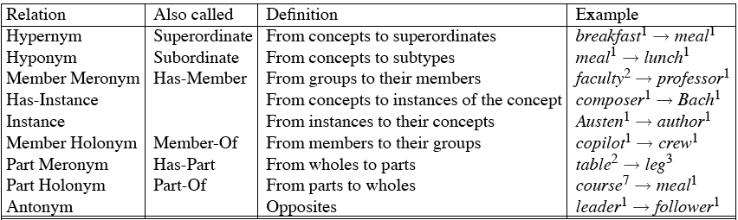
WordNet Noun Relations

Slide 23
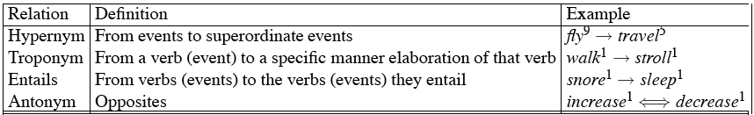
WordNet Verb Relations

Slide 24
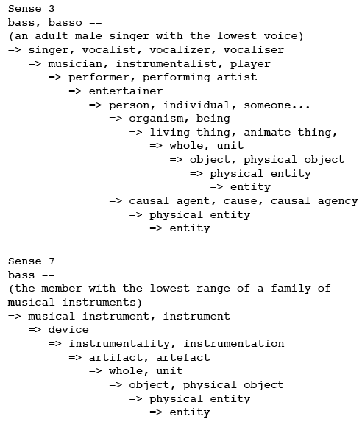
WordNet Hierarchies

Slide 25
How is “sense” defined in WordNet?
The set of near-synonyms for a WordNet sense is called a synset (synonym set); it’s their version of a sense or a concept.
Example: chump as a noun to mean
  ‘a person who is gullible and easy to take advantage of’
  chump#1, fool#2, gull#1, mark#9, patsy#1, fall guy#1, sucker#1, soft touch#1, mug#2 (a person who is gullible and easy to take advantage of)
Each of these senses share this same gloss
Thus, for WordNet, the meaning of this sense of chump is this list.

Slide 26
Word Sense Disambiguation (WSD)
Given
  A word in context,
  A fixed inventory of potential word senses
Decide which sense of the word this is
  English-to-Spanish MT
    Inventory is the set of Spanish translations
  Speech Synthesis
    Inventory is homographs with different pronunciations like bass and bow
  Automatic indexing of medical articles
  MeSH (Medical Subject Headings) thesaurus entries

Slide 27
Two variants of WSD task
Lexical Sample task
  Small pre-selected set of target words
  And inventory of senses for each word
All-words task
  Every word in an entire text
  A lexicon with senses for each word

Slide 28
Approaches
Supervised
Semi-supervised
  Unsupervised
    Dictionary-based techniques
    Selectional association
  Lightly supervised
    Bootstrapping
    Preferred Selectional Association

Slide 29
Supervised Machine Learning Approaches
Supervised machine learning approach:
  A training corpus of ?
  Used to train a classifier that can tag words in text
  Just as in part-of-speech tagging, statistical MT.
Summary of what we need:
  The tag set (“sense inventory”)
  The training corpus
  A set of features extracted from the training corpus
  A classifier

Slide 30
Supervised WSD 1: WSD Tag
What’s a tag?

Slide 31
WordNet Bass
The noun “bass” has 8 senses in WordNet
S: (n) bass#1 (the lowest part of the musical range)
S: (n) bass#2, bass part#1 (the lowest part in polyphonic music)
S: (n) bass#3, basso#1 (an adult male singer with the lowest voice)
S: (n) sea bass#1, bass#4 (the lean flesh of a saltwater fish of the family Serranidae)
S: (n) freshwater bass#1, bass#5 (any of various North American freshwater fish with lean flesh (especially of the genus Micropterus))
S: (n) bass#6, bass voice#1, basso#2 (the lowest adult male singing voice)
S: (n) bass#7 (the member with the lowest range of a family of musical instruments)
S: (n) bass#8 (nontechnical name for any of numerous edible marine and freshwater spiny-finned fishes)

Slide 32
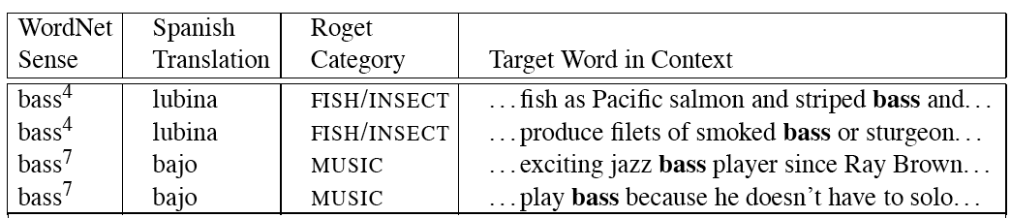
Inventory of sense tags for bass

Slide 33
Supervised WSD 2: Get a corpus
Lexical sample task:
  Line-hard-serve corpus -4000 examples of each
  Interest corpus -2369 sense-tagged examples
All words:
  Semantic concordance: a corpus in which each open-class word is labeled with a sense from a specific dictionary/thesaurus.
    SemCor: 234,000 words from Brown Corpus, manually tagged with WordNet senses
    SENSEVAL-3 competition corpora -2081 tagged word tokens

Slide 34
Dishes
Bass

Slide 35
washing dishes .
simple dishes including
convenient dishes to
of dishes and
free bass with
pound bass of
and bass player
his bass while

Slide 36
“In our house, everybody has a career and none of them includes washing dishes,” he says.
In her tiny kitchen at home, Ms. Chen works efficiently, stir-frying several simple dishes, including braised pig’s ears and chcken livers with green peppers.
Post quick and convenient dishes to fix when your in a hurry.
Japanese cuisine offers a great variety of dishes and regional specialties

Slide 37
We need more good teachers –right now, there are only a half a dozen who can play the free bass with ease.
Though still a far cry from the lake’s record 52-pound bass of a decade ago, “you could fillet these fish again, and that made people very, very happy.” Mr. Paulson says.
An electric guitar and bass player stand off to one side, not really part of the scene, just as a sort of nod to gringo expectations again.
Lowe caught his bass while fishing with pro Bill Lee of Killeen, Texas, who is currently in 144th place with two bass weighing 2-09.

Slide 38
Feature Vectors
A simple representation for each observation (each instance of a target word)
  Vectors of sets of feature/value pairs
  I.e. files of comma-separated values
These vectors should represent the window of words around the target
How big should that window be?

Slide 39
Two kinds of features in the vectors
Collocational features and bag-of-words features
  Collocational
    Features about words at specific positions near target word
    Often limited to just word identity and POS
  Bag-of-words
  Features about words that occur anywhere in the window (regardless of position)
  Typically limited to frequency counts

Slide 40
Collocational
Position-specific information about the words in the window
guitar and bass player stand
[guitar, NN, and, CC, player, NN, stand, VB]
Wordn-2,POSn-2,wordn-1,POSn-1,Wordn+1POSn+1…
In other words, a vector consisting of
[position n word, position n part-of-speech…]

Slide 41
Bag-of-words
Information about the words that occur within the window.
First derive a set of terms to place in the vector.
Then note how often each of those terms occurs in a given window.

Slide 42
Classifiers
Once we cast the WSD problem as a classification problem, then all sorts of techniques are possible
  Naïve Bayes (the easiest thing to try first)
  Decision lists
  Decision trees
  Neural nets
  Support vector machines
  Nearest neighbor methods…

